Slide 1
Presentation 2
CPSC 481 - T04 Group 1 Manraj, Usharab, Rian, Lucas, Esohe

Slide 2
Recap: Who We Are & Who Do We Work For
Who We Are
Manraj Singh
Esohe Aideyan
Usharab Khan
Lucas Kasdorf
Rian Tapang
Who Do We Work For
University of Calgary
>4 000 Staff
>37 000 Students
>217 000 Alumni
Notes:
Lucas

Slide 3




Recap: Summary
The Problem
There is no official centralized system for networking, meeting new people, and advertising/sharing events
Students utilize several different platforms to fulfill this need
Our Solution
Provide a unified network where users, such as clubs or students, can seek out and communicate with others by finding common interest groups and posting event listings for others to attend.
Accommodate for both students and clubs to make posts
Notes:
Lucas

Slide 4

Recap: Brief User List
Core Users
University Students
Student Clubs & Societies
Secondary Users
Professors
Teaching Assistants
University Alumni
University Admin
Notes:
Usharab

Slide 5

Recap: Tasks
List of Tasks Identified
Creating groups for users to connect through common interests
Adding comments, experiences under a post
Searching for groups that the one is interested in
Posting public events for other people to join
Communicating with individuals via direct messaging
Texting group chats about mutual interests
Notes:
Esohe

Slide 6

Prototypes Recorded Presentation - Manraj

Slide 7
Prototypes
Brainstorming and Prototyping Strategy
Ideation Sessions
Quickly sketched low-fidelity prototypes for steps in a task
Looked at existing solutions and their UI
Identified possible issues and things we liked

Slide 8
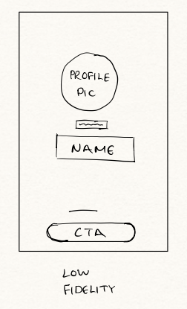
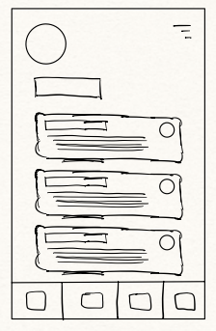
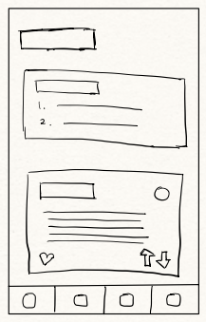
Low-fidelity Prototypes - Very Unrefined
Very unrefined, low level but contain general stylistic features

Slide 9
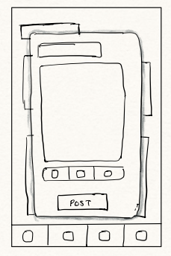
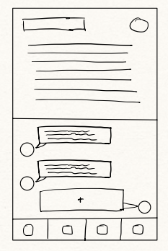
Low-fidelity Prototypes (Continued)
Very unrefined, low level but contain general stylistic features

Slide 10
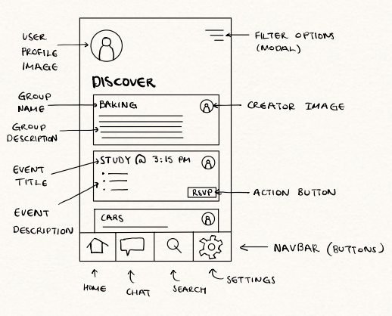
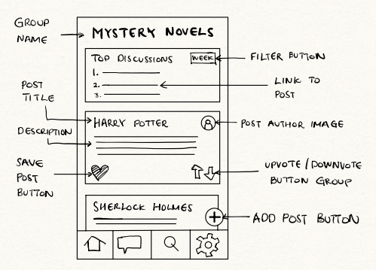
Detailed Prototypes For Scenario

Slide 11
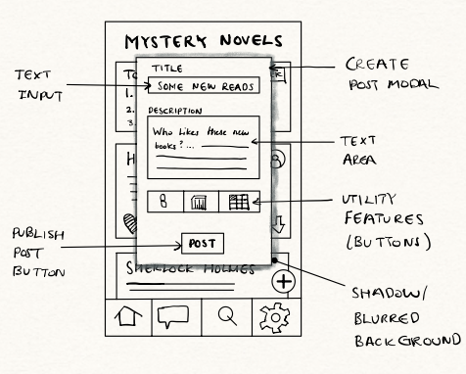
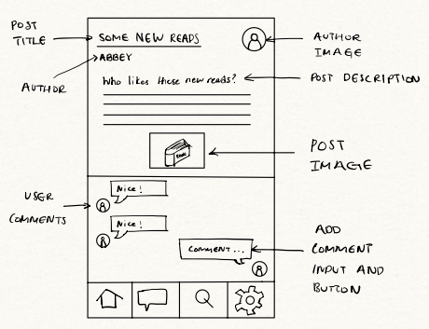
Detailed Prototypes For Scenario (Continued)

Slide 12
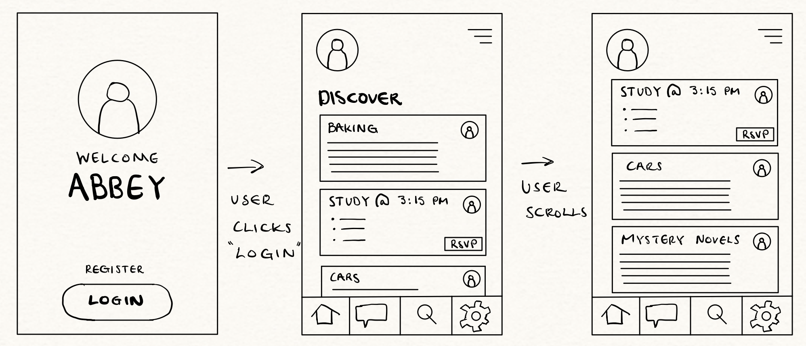
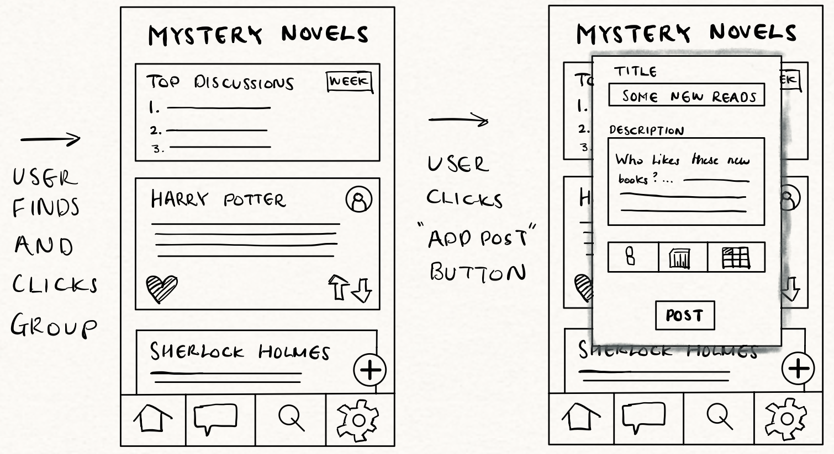
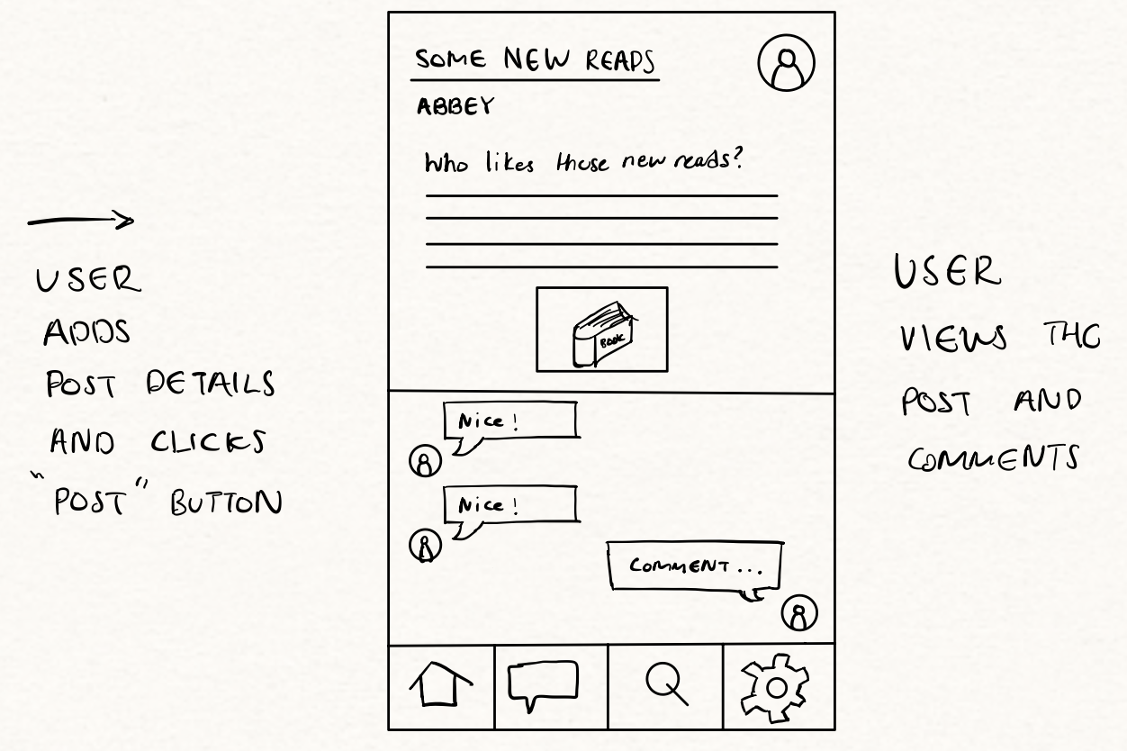
Screenflow Prototypes

Slide 13
Scenarios
Abbey Creates a Discussion Post in the Mystery Novels Group

Slide 14
Scenario: Abbey Creates a Discussion Post in the Mystery Novels Group
1. After finishing her classes in the late afternoon, Abbey decides to relax so she turns on her phone ready to open the social networking app to check for book discussions.
2. Abbey taps on the app icon on her phone home screen which displays the welcome screen with the options to login and register (1)
3. Abbey clicks on the login button and the screen transitions to the app’s home page which displays various content (2)
4. Abbey looks at the home page but does not immediately see the “Mystery Novels” group she is looking for, she then starts scrolling through the feed until she finds the group labeled “Mystery Novels” on the discover section.
5. Abbey taps on the group name to enter the page, the app displays the “Mystery Novels” group page, with the screen showing previous posts from other group members including top discussions (3)
6. On the Mystery Novels group page, Abbey clicks on the “Add Post” button represented by a “+” sign at the lower right corner of the screen, which opens a “Create Post” modal on her screen (4)

Slide 15
Scenario: Abbey Creates a Discussion Post in the Mystery Novels Group
7. Abbey clicks into the Title text input field to type a custom title for her post, she uses her phone’s keyboard to type: “SOME NEW READS” (5)
8. Abbey then clicks on the description text box to type her message using her phone’s keyboard: “Who likes these new reads?” (6)
9. Abbey taps on the “Post” button, satisfied with her post to submitting it to the group. The app processes the request and within seconds, it appears on the group feed for other group members to see. (7)

Slide 16
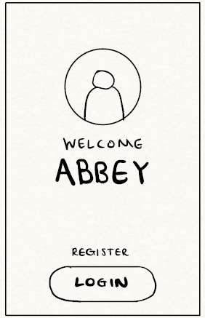
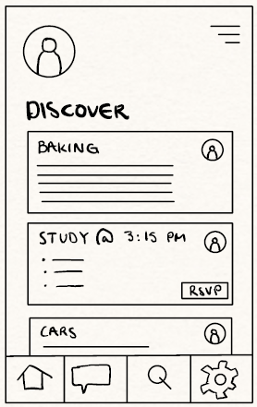
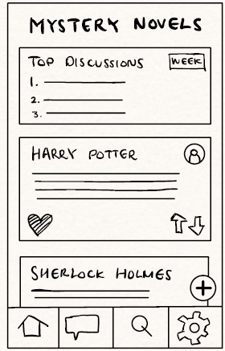
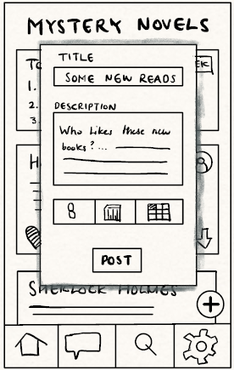
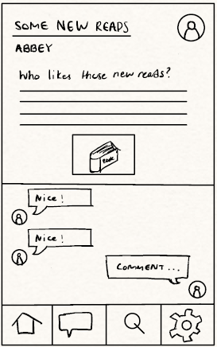
Scenarios
1
2

Slide 17
Scenarios
• Go through the entire sequence so that the audience understands both the task and how the user flowed through the prototype doing the task
• You can go fast through this as most scenarios should be straight-forward

Slide 18
Walkthroughs
o
Task Step | Knowledge? Believable? Motivated? | Comments/Solutions
1. After finishing her classes in the late afternoon, Abbey decides to relax so she turns on her phone ready to open the social networking app to check for book discussions. | Ok as long as she knows how to use a mobile application
2. Abbey taps on the app icon on her phone home screen which displays the welcome screen with the options to login and register (1) | Interface Problem if she must log in every time despite having previously done so. | Add a ‘remember me’ option in the login screen

Slide 19
Walkthroughs
o
Task Step | Knowledge? Believable? Motivated? | Comments/Solutions
4. Abbey looks at the home page but does not immediately see the “Mystery Novels” group she is looking for, she then starts scrolling through the feed until she finds the group labeled “Mystery Novels” on the discover section. | Can be frustrating if the frequently accessed group is not easily accessible | Display recently opened groups first
5. Abbey taps on the group name to enter the page, the app displays the “Mystery Novels” group page, with the screen showing previous posts from other group members including top discussions (3) | She expects the group page to be similar to other social platforms, where previous posts and top discussions are readily available. | Use popular designs for social media applications

Slide 20
Walkthroughs
o
Task Step | Knowledge? Believable? Motivated? | Comments/Solutions
6. On the Mystery Novels group page, Abbey clicks on the “Add Post” button represented by a “+” sign at the lower right corner of the screen, which opens a “Create Post” modal on her screen (4). | Ok as long as she is familiar with mobile applications and ‘+’ is intuitive for adding a post | Consider adding ‘Add’ text under the ‘+’ sign
9. Abbey taps on the “Post” button, satisfied with her post to submitting it to the group. The app processes the request and within seconds, it appears on the group feed for other group members to see. (7) | Post button could be mistakenly pressed before completion | Disable post button until certain fields are filled and add an option to preview post before posting

Slide 21
Walkthrough Summary
The prototype satisfies Abbey’s task of posting in the “Mystery Novels” group. However, there are key issues that need attention:
Group Discovery: Abbey has to scroll through the feed to find the “Mystery Novels” group. A “Recently Visited” section would improve the user experience.
Post Confirmation: After posting, there is no clear confirmation that her post was submitted successfully. A brief notification or visual cue would assure Abbey that her action was completed.
Improving these elements would make Abbey’s experience smoother and more intuitive.

Slide 22

Thank you! Questions?

Slide 28
Presentation 1
CPSC 481 - T04 Group 1 Manraj, Usharab, Rian, Lucas, Esohe

Slide 29
Who We Are
Notes:
Everyone introduces themselves individually

Slide 30

University of Calgary
Size
Staff (academic and non-academic): 4750
Students
Currently enrolled: 37 000 +
Alumni: 217 000 +
Philosophy and Vision
Create an engaging learning and social environment that fosters growth and community
World-class research and innovation to promote societal growth
Notes:
Lucas

Slide 31

What’s the Problem?
Lack of centralized official system provided by the University of Calgary
Students resort to multiple platforms for discussions and finding out about events
Notes:
Lucas

Slide 32

What are the constraints you’re working with?
Privacy/Security
Responsive Design and Accessibility
Respect University Culture and Rules
Scalability
Time and Resources
Notes:
Manraj

Slide 33

Privacy/Security
Data privacy
Sensitive user information must remain confidential
System must be designed to prevent a data breach
Proper user authentication and security
Encrypt data
Password hashing and reset mechanisms
Authentication
Multi-factor authentication, session management
Role based access control
Secure communication
Notes:
Manraj

Slide 34

Responsive Design and Accessibility
Device agnostic
Mobile phones, tablets, laptops, desktops
Audio and Visual Assistive Technology
Screen reading
Captions for videos
Descriptions for audio
Notes:
Manraj

Slide 35

Respect University Culture and Rules
Adherence to University Policies
User conduct and content guidelines
Privacy and data security policies
Academic integrity policies
Cultural Sensitivity, Diversity and Inclusion
Promote diversity and inclusion for all members
Campus Resource Integration
Notes:
Manraj

Slide 36

Scalability
Due to the large numbers of potential users (students, alumni etc.) the application must scale well!
Designed in a way that can handle:
Increased spikes of traffic
Continuous increased levels of traffic
We must ensure:
Efficient data management and consistency
Low load times
High fault tolerance
Designed for growth
Notes:
Manraj

Slide 37

Time and Resources
Designed in a way that is:
Easily maintainable
Easy to release updates
Easy to identify/fix bugs and issues
Extensible
Most development costs go towards software maintenance!
Cost Constraints
Infrastructure/cloud costs must align with number of users
Auto-scaling mechanisms to scale cost as traffic increases/decreases
Notes:
Manraj

Slide 38

How did we do our research?
As university students ourselves, we were able to easily personally interview many potential users for our application (direct and mutual friends)
Combining this with personal experience, we were able to identify the pain points of the existing solution and address those in our product.
Notes:
Manraj

Slide 39

Summary of Previous Slides and Context
University of Calgary is a well-established institution with a lot of members
Staff
Students
Alumni
Mission to provide an engaging educational environment that promotes growth and fosters innovation
Lack of an official unified platform that promotes networking
Centralized social network to address this problem
Build a well-designed and usable product given various constraints
Notes:
Manraj

Slide 40
Brief User List
Core Users
University Students
Student Clubs & Societies
Secondary Users
Professors
Teaching Assistants
University Alumni
University admins
Notes:
Usharab

Slide 41

User 1
Gale Smith
20 years old. International student studying Computer Science at the University of Calgary. Moved from Los Angeles, USA 2 years ago for university. Member of tech and cultural clubs at UofC.
Part of the most common user group.
Already familiar with well known social media applications.
Notes:
Usharab

Slide 42
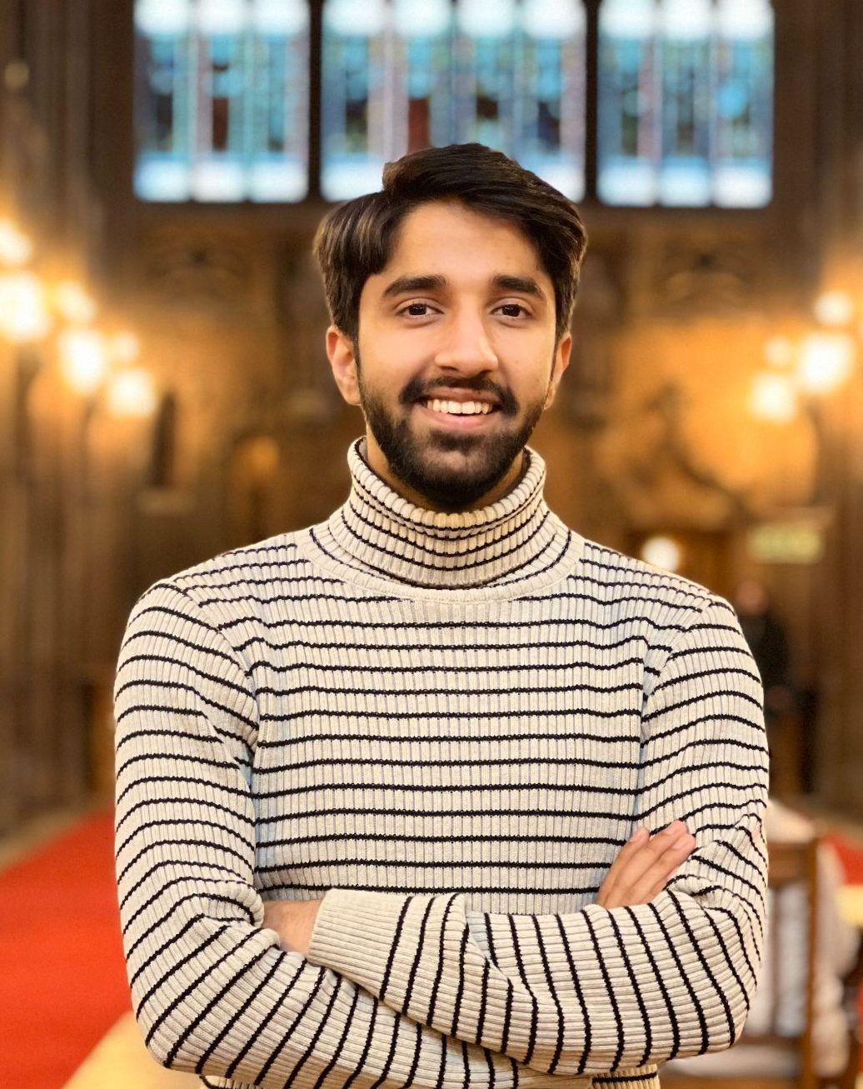
User 2
Usharab Khan
Director of Events at the Pakistani Students’ Society at UofC. Has been with the club for over 2 years. Manages the planning, organization and promotion of the clubs’ events amongst university students.
Part of a common user group.
Already familiar with well known social media applications.
Notes:
Usharab

Slide 43
Tasks
List of Tasks Identified
Creating groups for users to connect through common interests
Adding comments, experiences under a post
Searching for groups that the one is interested in
Posting public events for other people to join
Communicating with individuals via direct messaging
Texting group chats about mutual interests
Notes:
Esohe

Slide 44

Task 1
Josh, a software engineering student at the University of Calgary, excited at the thought of playing Call of Duty, is passionate about FPS and looking to find like-minded individuals. In order to do so, he opens the mobile application designed for the social network to create and manage groups within the app. He navigates to the groups tab and fills in the name of the group, the description of the group and clicks submit to create the group. Josh does this in the evening right before playing a game as creating a group and setting it up takes approximately 5 - 10 mins, and can be completed during short sessions.
Notes:
Esohe

Slide 45

Task 2
Abbey, a psychology student at the University of Calgary, is an avid fan of mystery novels and is fond of discussing theories with fellow readers. She opens the mobile app designed for social networking while relaxing in her dorm seeking a cozy way to connect with her peers. She clicks into the group chat for mystery novel readers and sends a message asking what everyone has been reading recently. The responses soon start flooding in sparking a lively conversation about their mutual interests. Abbey is doing this task in the late afternoon after her classes, anticipating that composing and sending the message will take about 5 mins.
Notes:
Esohe

Slide 46

Requirements
Core Users
Students
Student Clubs & Societies
Secondary Users
Alumni
Notes:
Rian

Slide 47
Must Include | Should Include | Might Include | Exclude
Creating a user profile | Posting public events for other users to join | Direct Messaging functionality | AI Recommendations for groups to join
Search for and join a group to discuss about common interests | Adding comments or experiences | Edit User Profile | Promotions/ads about events
Creating groups for users to connect through common interests | Edit Event Details/Edit Post details | Like System for Posts/Threads | AI Chatbot
Notes:
Rian

Slide 48
To Summarize
The Problem
There is no official centralized system for networking, meeting new people, and advertising/sharing events
Students may utilize several different platforms which can be a hassle to keep track of
Our Solution
Provide a unified network where users, such as clubs or students, can find and communicate with others sharing common interests and post event listings for others to attend
Accommodate for both students and clubs to make posts
Tasks and requirements are prioritized based on how frequently we think they will be utilized
Notes:
Lucas

Slide 49
Thank you! Questions?

